Slide 1
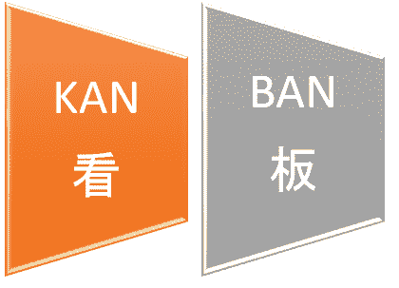
KANBAN SE Spring 2021

Slide 2
Kanban
The name 'Kanban' originates from Japanese, it means "signboard”, “billboard”
Used for Just in Time (JIT) manufacturing at Toyota manufacturing plants in Japan to limit the amount of inventory tied up in “work in progress” (WIP) on a manufacturing floor
Kanban is a lean agile system that can be used to enhance any software development lifecycle including Scrum, XP, or Waterfall.
Notes:
Agile aims to deliver working software as quickly as possible. ... The difference is that in Lean thinking, teams increase speed by managing flow (usually by limiting work-in-process), whereas in Agile, teams emphasize small batch sizes to deliver quickly (often in sprints).

Slide 3
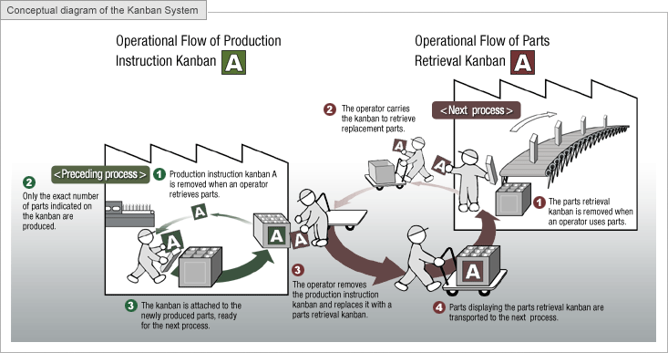
Toyota follows Kanban for their production line

Slide 4
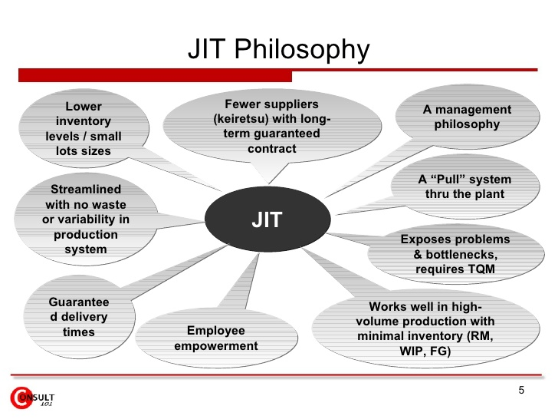
What is JIT
Notes:
https://www.investopedia.com/terms/j/jit.asp
TQM stands for total quality management
RM raw material
WIP work in progress
FG finished goods

Slide 5
Similarities between Agile principles and JIT
Some Agile principles and practices that already use JIT approach:
“Responding to change over following a plan” (Agile Manifesto – value)
“Our highest priority is to satisfy the customer through early and continuous delivery of valuable software.” (Agile Manifesto – principle)
“Deliver working software frequently, from a couple of weeks to a couple of months, with a preference to the shorter timescale” (Agile Manifesto – principle)
“Business people and developers must work together daily throughout the project.” (Agile Manifesto – principle)
“Make frequent small releases.” (XP rule)
“No functionality is added early.” (XP rule)
Simple design (XP Practice)
Model Storming (Agile Modeling / DAD – Disciplined Agile Delivery practice)
Document late, document continuously (Agile Modeling / DAD practice)
Active stakeholder participation (Agile Modeling / DAD practice)
Just Barely Good Enough (Agile Modeling / DAD practice)
Explicit support for JIT based life-cycles: Agile, Lean, Exploratory (DAD – Disciplined Agile Delivery)
Inspect and Adapt (Scrum principle)

Slide 6
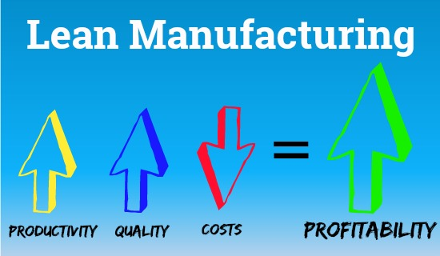
Lean Principles
What are Lean principles
1. Eliminate Waste | 5. Deliver Fast
2. Build Quality | 6. Respect People
3. Create Knowledge | 7. Optimize the Whole
4. Defer Commitment

Slide 7
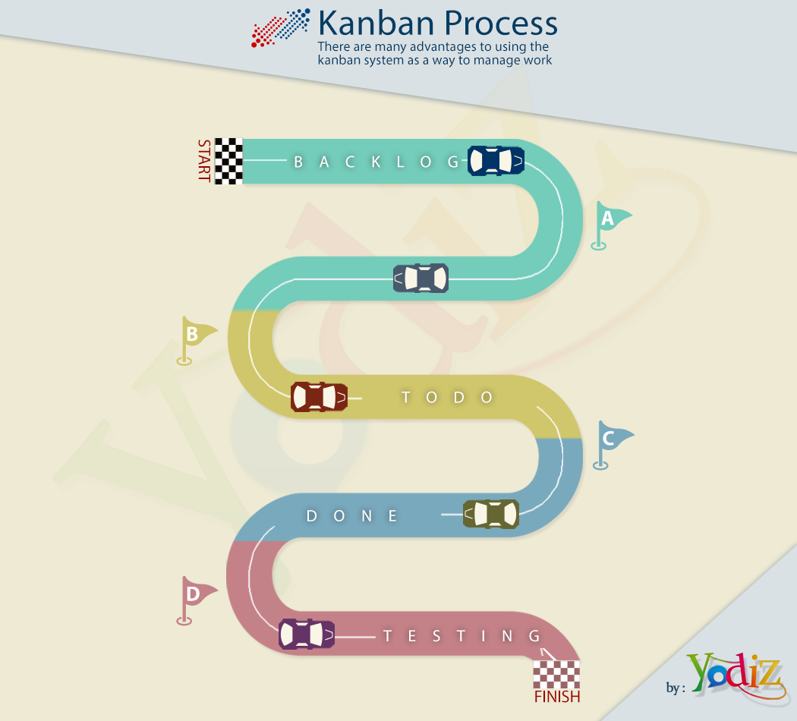
Kanban Process – Basic ceremonies

Slide 8
Work Process Flow or basic Ceremonies of Kanban
Analysis
Create specification and acceptance criteria
Product Owners
Development
Code features, fix bugs
Engineering Team
Test
Test features and bug fixes
QA Team
Merge and Deploy
Release features and bug fixes to customers

Slide 9
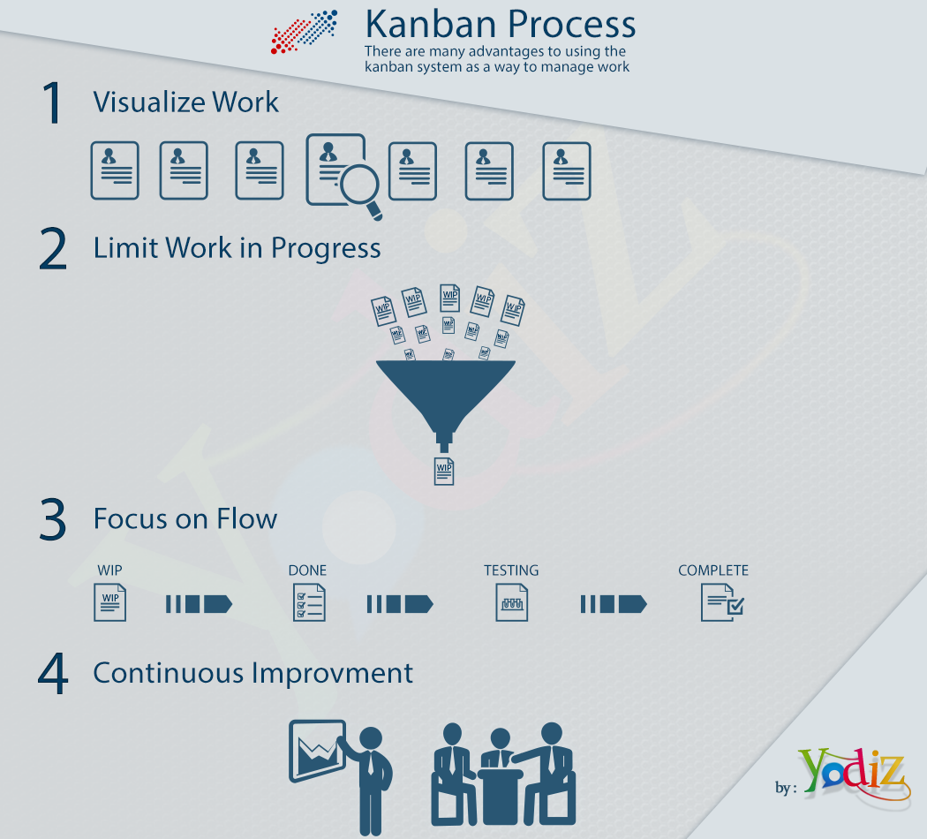
Basic Principles of Kanban
Notes:
Kanban promotes the lean concept of flow
to continuously and predictably deliver value.
The work and the workflow is made visible
to make activities and issues like backups obvious.
Kanban limits work in progress

Slide 10
Why limit the WIP?
Limiting WIP may have the following effects:
Reduces cycle time per task
Insures WIP is highest priority task
Reduces or eliminates queues between groups
Reduces multi-tasking by team members
Reduces lead times and increases quality

Slide 11
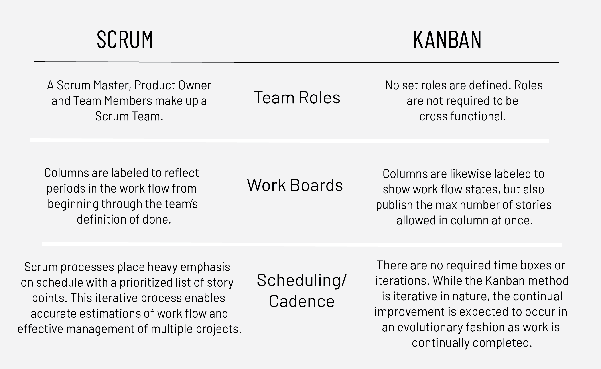
Basic Differences between Scrum and Kanban
Notes:
Work is pulled in batches in Scrum – work is pulled as a whole in Kanban

Slide 12
Kanban VS Scrum
Scrum Iterative, cyclic, planned response to change Manage on monthly, quarterly, annual roadmap Change in priority addressed between sprints Delivery content limited by number of resources and release dates Fit with Project management Budget planed based on release dates, development Estimates and resources Supports cross-platform and program-level integration well Target date-driven releases Progress is Visual Sprint Burn-Down Release Burn-up | Kanban Incremental, immediate response to change Manage on “patch” or “continuous release” basis Change in Priority addressed continuously Delivery content limited by the number of resources Fit with Project management Budget plan based on resources Supports Isolated or independent changes well Target Content driven releases Progress is Visual Cumulative Flow Cycle Time

Slide 14
Summarising differences between Scrum-Kanban
Kanban has less rules than Scrum (e.g. No time boxes, no fixed iterations, no specific roles, no set deliverables)
Kanban is great methodology for Maintenance works (where the needs to adapt to customer input on a daily basis.)
Scrum is good for development that is heavily dependent on stakeholders' feedback (e.g. The sprint reviews with customers after every sprint)
Using a Kanban approach in software drops time-boxed iterations i.e. Springts in favor of focusing on continuous flow.
Scrum doesn’t allow changes within sprints, Kanban is flexible.
Both allow working on multiple products (or modules) simultaneously.

Slide 15
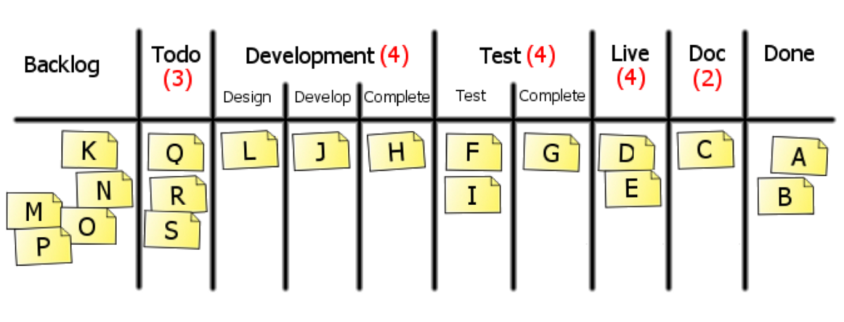
Kanban (message)Board-example
Notes:
Focus on WIP limit – distributed to dev and testing phase .
Kanban cards that present separate tasks. The higher place the card has, the highest priority it gets. Tasks pass through as many columns as your chosen workflow allows. Additional elements (filters, labels (tags), due dates, etc.)

Slide 16


Explode large process steps into tasks to improve visibility
When a feature, user story, or work item is large:
Takes longer than a couple days to complete
Requires that multiple people collaborate on its completion
Decompose that step into cards to track independently
Feature to develop
Tasks in progress
Tasks complete
Feature complete
Tasks in queue

Slide 17
Scrum/Kanban is best fit for ?
Scrum New Application Dev Major/minor enhancements Brand development Marketing Campaigns Large enterprises with quarterly/timed release schedules | Kanban Production support Bi/Report Development Art Design and Production Ux Design Patch Releases Marketing Collateral Press Releases
Kanban is more for quick turnarounds and fast-moving teams where as Scrum can have a larger project that may take longer.
Kanban is a simpler option for small projects, with only a limited number of issues.
Scrum on the other hand, will offer teams a greater organization and overview.

